Slide 1
TCP/IP Computer Networks
Networks and Internet Topology
José Legatheaux Martins
Departamento de Informática da
FCT/UNL

Slide 2
Lecture Overview
Router-level topology with a single network
  Points of Presence (PoPs)
  Backbone and enterprise network topologies
AS-level topology of the Internet
  Autonomous System (AS) numbers
  Tier-1 ISPs, regional providers, and stub ASes
  Business relationships between Ases
Using some slides from the course
  Computer Networks, COS461, Jennifer Rexford, Princeton University, 2007 Edition

Slide 3
Router-level topology of a network

Slide 4
Intra-AS Topology
Node: router
Edge: link

Slide 5
Hub-and-Spoke Topology
Single hub node
  Common in enterprise networks
  Main location and satellite sites
  Simple design and trivial routing
Problems
  Single point of failure
  Bandwidth limitations
  High delay between sites
  Costs to backhaul to hub

Slide 6
Campus Example
Hub-and-spoke
  Four hub routers and many spokes
Hub routers
  Outside world
  Dorms
  Academic and administrative buildings
  Servers

Slide 7
Simple Alternatives to Hub-and-Spoke
Dual hub-and-spoke
  Higher reliability
  Higher cost
  Good building block
Levels of hierarchy
  Reduce backhaul cost
  Aggregate the bandwidth
  Shorter site-to-site delay
…

Slide 8
Traditional Data-Center Routing Levels
Internet
CR
CR
DC-Layer 3
. . .
AR
AR
AR
AR
DC-Layer 2
S
S
S
S
S
S
S
S
. . .
S
S
S
S
Key
CR = Core Router (L3)
AR = Access Router (L3)
S = Ethernet Switch (L2)
A = Rack of app. servers ≈ 40 servers each
A pod has ≈ 20 to 25 racks
A
A
…
A
A
A
…
A
~ 1,000 servers/pod == IP subnet

Slide 9
Capacity Mismatch
CR
CR
~ 200:1
AR
AR
AR
AR
S
S
S
S
~ 40:1
S
S
S
S
. . .
S
S
S
S
~ 5:1
A
A
…
A
A
A
…
A
A
A
…
A
A
A
…
A

Slide 10
Rings
…
Rings are a cost effective alternative
  Less links
  Still redundant
  But, longer site-to-site delay
  Most rings are bidirectional
  Adopted in many MAN
…
…
…

Slide 11
Backbone Networks
Backbone networks
  Multiple Points-of-Presence (PoPs)
  Lots of communication between PoPs
  Accommodate traffic demands and limit delay

Slide 12
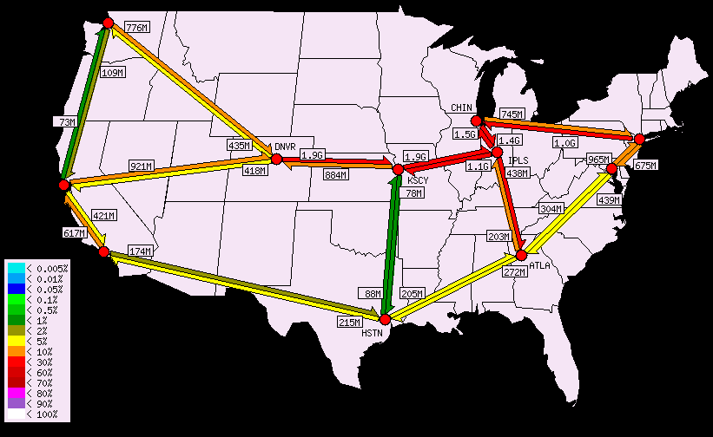
Abilene Internet2 Backbone

Slide 13
Where to Locate Nodes and Links
Placing Points-of-Presence (PoPs)
  Large population of potential customers
  Other providers or exchange points
  Cost and availability of real-estate
  Mostly in major metropolitan areas
Placing links between PoPs
  Already fiber in the ground
  Needed to limit propagation delay
  Needed to handle the traffic load

Slide 14
Tier-1 ISP: e.g. Sprint

Slide 15
POP: Point of Presence
POP: point-of-presence
to/from backbone
peering
…
…
…
…
…
to/from customers

Slide 16
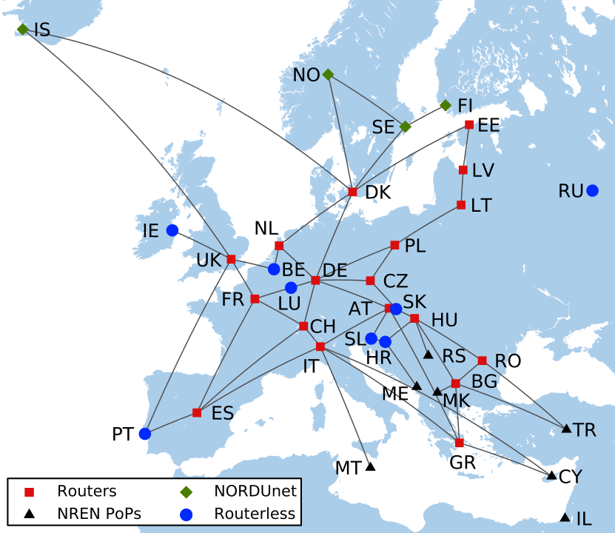
An European Backbone: Géant

Slide 17
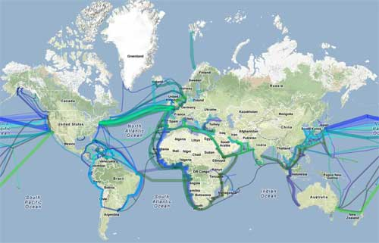
Connecting Continents

Slide 18
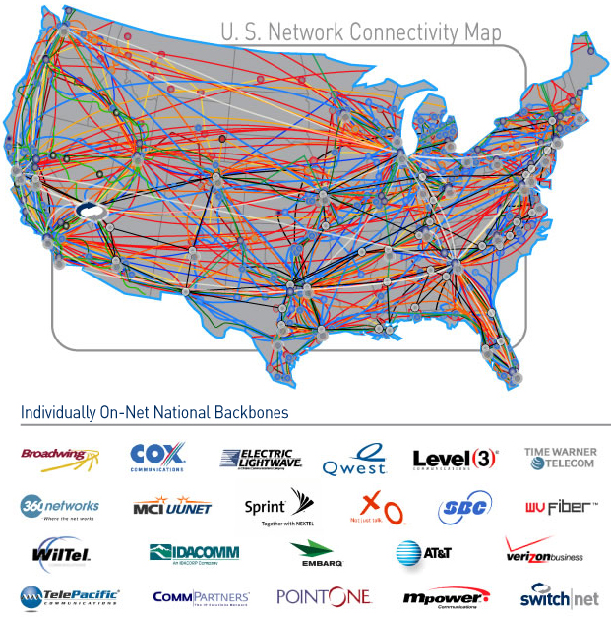
Several Interconnected Backbones

Slide 19
Internet Structure
…
…
access
net
access
net
access
net
access
net
access
net
IXP
access
net
access
net
ISP A
…
…
Content provider network
IXP
access
net
access
net
ISP B
ISP B
access
net
access
net
access
net
regional net
access
net
…
access
net
access
net
…
access
net

Slide 20
Internet Structure
Tier 1 ISP
Tier 1 ISP
CDN (Google)
IXP
IXP
IXP
Regional ISP
Regional ISP
access
ISP
access
ISP
access
ISP
access
ISP
access
ISP
access
ISP
access
ISP
access
ISP
No centro da Internet encontramos
  “tier-1” transit ISPs (e.g., Level 3, Sprint, AT&T, NTT), national & international coverage
  content provider networks (e.g, Google)

Slide 21
AS-level topology of the Internet

Slide 22
Internet Routing Architecture
Divided into Autonomous Systems
  Distinct regions of administrative control
  Routers/links managed by a single “institution”
  Service provider, company, university, …
“Hierarchy” of Autonomous Systems
  Large, tier-1 provider with a worldwide backbone
  Medium-sized regional provider with smaller backbone
  Small network run by a single company or university
Interaction between Autonomous Systems
  Internal topology is not shared between ASes
  … but, neighboring ASes interact to coordinate routing

Slide 23
Autonomous System Numbers
AS Numbers are 16 bit values.
Currently just over 40,000 in use.
Level 3: 1
MIT: 3
Harvard: 11
Yale: 29
Princeton: 88
EUnet: 286 (now KPN)
EUnet Portugal: 1897 (1990 ....)
RCCN Portugal: 1930 (1990 ....)
AT&T: 7018, 6341, 5074, …
UUNET: 701, 702, 284, 12199, …
Sprint: 1239, 1240, 6211, 6242, …
…

Slide 24

AS Topology
Node: Autonomous System
Edge: Two ASes that connect to each other
4
3
5
2
7
6
1

Slide 25
Types of ASs
Stub AS: it is a pure customer of a provider AS. In fact, it doesn’t need to be a real AS with a specific number
Multihomed AS: it is an AS that has connections to more than than one AS but refuses to carry transit traffic
Transit AS: an AS that has connections to more than one other AS and that is designated to carry both transit and local traffic

Slide 26
What is an Edge, Really?
Edge in the AS graph
  At least one connection between two ASes
  Some destinations reached from one AS via the other (a transit AS)
d
d
AS 1
AS 1
Exchange Point
AS 2
AS 2
AS 3

Slide 27
Interdomain Paths
Path: 6, 5, 4, 3, 2, 1
4
3
5
2
7
6
1
Web server
Client

Slide 28
Business Relationships
Neighboring ASes have business contracts
  How much traffic to carry
  Which destinations to reach
  How much money to pay
Common business relationships
  Customer-provider
    E.g., FCT/UNL is a “customer” of RCCN
    E.g., GEANT is a “provider” of RCCN
  Peer-peer
    E.g., RCCN is a peer of PT Comunicações
    E.g., AT&T is a peer of Sprint

Slide 29
Customer-Provider Relationship
Customer needs to be reachable from everyone
  Provider tells all neighbors how to reach the customer
Customer does not want to provide transit service
  Customer does not let its providers route through it
Traffic to the customer
Traffic from the customer
d
provider
advertisements
provider
traffic
customer
d
customer

Slide 30
Advertisements and routing
AS₁ knows there is a path to a destination if it received an advertisement from another AS telling it
  E.g. provider tells all neighbors that the customer is reachable through it
ASs only route packets to destinations which existence they learned from advertisements
advertisements
provider
traffic
d
customer

Slide 31
Customer Connecting to a Provider
Provider
Provider
1 access link
2 access links
Provider
Provider
2 access routers
2 access PoPs

Slide 32
Multi-Homing: Two or More Providers
Motivations for multi-homing
  Extra reliability, survive single ISP failure
  Financial leverage through competition
  Better performance by selecting better path
  Gaming the 95th-percentile billing model
Provider 1
Provider 2

Slide 33
Peer-Peer Relationship
Peers exchange traffic between customers
  AS exports only customer routes to a peer
  AS exports a peer’s routes only to its customers
  Often the relationship is settlement-free (i.e., no $$$)
Traffic to/from the peer and its customers
advertisements
peer
peer
traffic
d

Slide 34
AS Structure: Tier-1 Providers
Tier-1 transit provider
  Has no upstream provider of its own
  Typically has a national or international backbone
  For example, it has a transit only AS
  UUNET, Sprint, AT&T, Level 3, …
Top of the Internet hierarchy of 12-20 ASes
  Full peer-peer connections between tier-1 providers
Tier-1 CDN provider
  Has no or low number of upstream provider of its own
  Typically has an international backbone connecting data centers
  Has many caching server POPs
  Offers peering for free

Slide 35
Efficient Early-Exit Routing
Diverse peering locations
  Both sides of the Atlantic, both costs of US, middle of US, middle of Europe, …
Comparable capacity at all peering points
  Can handle even load
Consistent routes
  Same destinations advertised at all points
  Same AS path length for a destination at all points
Customer B
Provider B
multiple
peering
points
Early-exit
routing
Provider A
Customer A

Slide 36
AS Structure: Other ASes
Tier-2 providers
  Provide transit service to downstream customers
  … but, need at least one provider of their own
  Typically have national or regional scope
  E.g., Minnesota Regional Network, RCCN, ...
  Includes a few thousand of the ASes
Stub ASes
  Do not provide transit service to others
  Connect to one or more upstream providers
  Includes vast majority (e.g., 85-90%) of the ASes

Slide 37
Characteristics of the AS Graph
AS graph structure
  High variability in node degree (“power law”)
  A few very highly-connected ASes
  Many ASes have only a few connections
1
All ASes have 1 or more neighbors
0.1
CCDF
0.01
Very few have degree >= 100
0.001
1
10
100
AS degree
1000

Slide 38
Characteristics of AS Paths
AS path may be longer than shortest AS path
Router path may be longer than shortest AS path
2 AS hops,
8 router hops
s
d
3 AS hops, 7 router hops

Slide 39
Conclusions
Internet topology
  Network inside an AS
  Network connecting Ases

