Slide 1
TCP/IP Computer Networks
Wireless Shared Links
José Legatheaux Martins
Departamento de Informática da
FCT/UNL

Slide 2
Lecture Outline
Characteristics of wireless links
Wifi: IEEE 802.11 Wireless links
CSMA/CD
Some observations on the implications of this kind of links
Using slides from the companion site of
  James F. Kurose and Keith W. Ross, “Computer Networking - A Top-Down Approach Featuring the Internet,” Addison Wesley

Slide 3
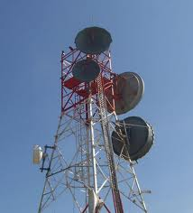

Wireless point-to-point

Slide 4
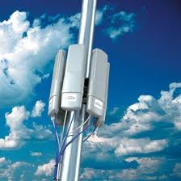
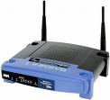
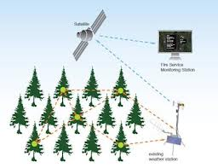

Wireless as shared media

Slide 5
Wireless Properties
Interference / bit errors
  More sources of corruption compared to wired
Multipath propagation
  Signal does not travel in a straight line
Broadcast medium
  All traffic to everyone
  The medium is a scarce resource, highly controlled
Power trade-offs
  Important for power constrained devices

Slide 6
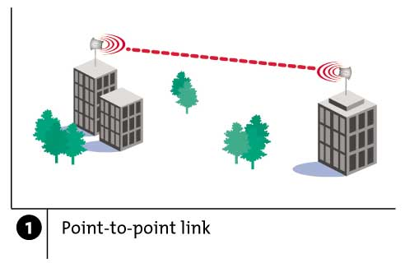
Wireless Links: High Bit Error Rate
Decreasing signal strength
  Disperses as it travels greater distance
  Attenuates as it passes through matter

Slide 7
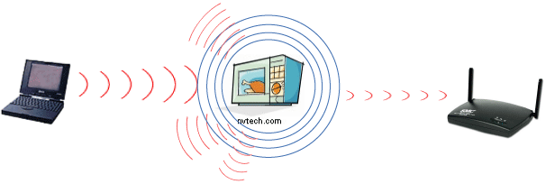
Wireless Links: High Bit Error Rate
Interference from other sources
  Radio sources in same frequency band
  E.g., 2.4 GHz wireless phone interferes with 802.11b wireless LAN
  Electromagnetic noise (e.g., microwave oven)

Slide 8
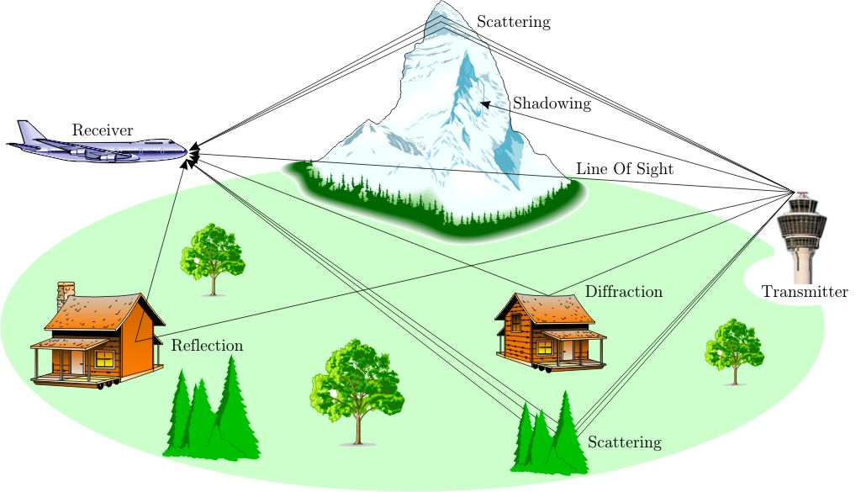
Wireless Links: High Bit Error Rate
Multi-path propagation
  Electromagnetic waves reflect off objects
  Taking many paths of different lengths
  Causing blurring of signal at the receiver
receiver
transmitter

Slide 9
Dealing With Bit Errors
Wireless vs. wired links
  Wired: most loss is due to congestion
  Wireless: higher, time-varying bit-error rate
Dealing with high bit-error rates
  Sender could increase transmission power
    Requires more energy (bad for battery-powered hosts)
    Uses more of a scarce resource
    Creates more interference with other senders
  Stronger error detection and recovery
    More powerful error detection/correction codes
    Link-layer retransmission of corrupted frames

Slide 10
Wireless Links: Broadcast Limitations
Wired broadcast links
  E.g., Ethernet bridging, in wired LANs
  All nodes receive transmissions from all other nodes
Wireless broadcast: hidden terminal problem
A and B hear each other
B and C hear each other
But, A and C do not
So, A and C are unaware of their interference at B
C
B
A

Slide 11
Wireless Links: Broadcast Limitations
Wired broadcast links
  E.g., Ethernet bridging, in wired LANs
  All nodes receive transmissions from all other nodes
Wireless broadcast: fading over distance
A
B
A and B hear each other
B and C hear each other
But, A and C do not
So, A and C are unaware of their interference at B
C
A’s signal
strength
C’s signal
strength
space

Slide 12
Example Wireless Link Technologies
Data networks
  802.15.1 (Bluetooth): 2.1 Mbps – 10 m
  802.11b (WiFi): 5-11 Mbps – 100 m
  802.11a and g (WiFi): 54 Mbps – 100 m
  802.11n (WiFi): 200 Mbps – 100 m
  802.16 (WiMax): 70 Mbps – 10 km
Cellular networks, outdoors
  2G: 56 Kbps
  3G: 384 Kbps
  3G enhanced (“4G”): > 4 Mbps
  LTE: > 100 Mpbs

Slide 13
Wifi: IEEE 802.11 Wireless LANs
Wifi LANs are more than just a shared media link
Two modes of operation, infrastructure mode and ad-hoc mode
We will concentrate on the infrastructure mode but the media access control protocols are similar

Slide 14
Wireless Networks: Base Station
Base station
Typically connected to wired network
Relay responsible for sending packets between wired network and wireless host(s) in its “area”
E.g., cell towers, 802.11 access points
network
infrastructure

Slide 15
802.11 LAN Architecture
Access Point (AP)
  Base station that communicates with the wireless hosts
Basic Service Set (BSS)
  Coverage of one AP
  AP acts as the master
  Identified by an “network name” known as an SSID
Internet
hub, switch
or router
AP
BSS 1
AP
SSID: Service Set Identifier
BSS 2

Slide 16
Channels and Association
Multiple channels at different frequencies
  Network administrator chooses frequency for AP
  Interference if channel is same as neighboring AP
Access points send periodic beacon frames
  Containing AP’s name (SSID) and MAC address
  Host scans channels, listening for beacon frames
  Host selects an access point to associate with
Beacon frames from APs
Associate request from host
Association response from AP

Slide 17
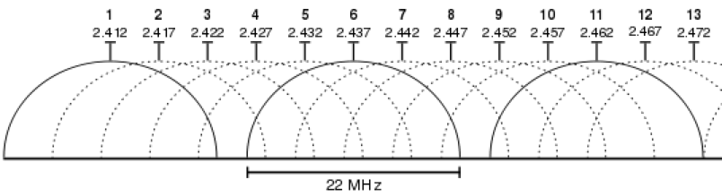
Channels and Association
Multiple channels at different frequencies
  Network administrator chooses frequency for AP
  Interference if channel is same as neighboring AP
Beacon frames from APs
Associate request from host
Association response from AP

Slide 18
CSMA: Carrier Sense, Multiple Access
Multiple access: channel is shared medium
  Station: wireless host or access point
  Multiple stations may want to transmit at same time
Carrier sense: sense channel before sending
  Station doesn’t send when channel is busy
  To prevent collisions with ongoing transfers
  But, detecting ongoing transfers isn’t always possible
A
B
C
C
A’s signal
strength
C’s signal
strength
B
A
space

Slide 19
CA: Collision Avoidance, Not Detection
Collision detection in wired Ethernet
  Station listens while transmitting
  Detects collision with other transmission
  Aborts transmission and tries sending again
Problem #1: cannot detect all collisions
  Hidden terminal problem
  Fading
Problem #2: listening while sending
  Strength of received signal is much smaller
  Expensive to build hardware that detects collisions
So, 802.11 does collision avoidance, not detection

Slide 20
IEEE 802.11 MAC Protocol: CSMA/CA
802.11 sender
if sense channel idle for DIFS then transmit entire frame (no Collision Detection)
if sense channel busy then start random backoff time, timer counts down while channel idle and transmit when timer expires,
if no ACK, increase random backoff interval, repeat previous step for up to three or four times
802.11 receiver
if frame received OK, return ACK after SIFS (ACK needed due to hidden terminal problem)
Backoff interval starts at [ 0, 31 ] and doubles in each round
sender
receiver
DIFS
data
SIFS
ACK

Slide 21
IEEE 802.11 MAC Protocol: CSMA/CA

Slide 22
Virtual carrier sensing (RTS/CTS)
First exchange control frames before transmitting data
  Sender issues “Request to Send” (RTS), incl. length of data
  Receiver responds with “Clear to Send” (CTS)
If sender sees CTS, transmits data (of specified length)
If other node sees CTS, will idle for specified period
If other node sees RTS but not CTS, free to send

Slide 23
RTS-CTS exchange
A
B
AP
RTS(B)
RTS(A)
reservation collision
RTS(A)
CTS(A)
CTS(A)
DATA (A)
defer
time
ACK(A)
ACK(A)

Slide 24
Hidden Terminal Problem
B
A
C
A and C can’t see each other, both send to B
RTS/CTS can help
  Both A and C would send RTS to B
  B only responds with one CTS, the first received
  C detects that CTS doesn’ t match and won’t send

Slide 25
Exposed Terminal Problem
A
B
C
D
B sending to A, C wants to send to D
As C receives B’s packets, carrier sense would prevent it from sending to D, even though wouldn’t interfere
RTS/CTS can help
  C hears RTS from B, but not CTS from A
  C knows it’s transmission will not interfere with A
  C is safe to transmit to D

Slide 26
Mobility Within the Same Subnet
H1 remains in same IP subnet
  IP address of the host can remain same
  Ongoing data transfers can continue uninterrupted
H1 recognizes the need to change
  H1 detects a weakening signal
  Starts scanning for stronger one
Changes APs with same SSID
  H1 disassociates from one
  And associates with other
Switch learns new location
  Self-learning mechanism
router
hub or
switch
BBS 1
AP 1
AP 2
H1
BBS 2

Slide 27
Impact on Higher-Layer Protocols
Wireless and mobility change path properties
  Wireless: higher packet loss, not from congestion
  Mobility: transient disruptions, and changes in RTT
Logically, impact should be minimal …
  Best-effort service model remains unchanged
  TCP and UDP can (and do) run over wireless, mobile
But, performance definitely is affected
  TCP treats packet loss as a sign of congestion
  TCP tries to estimate the RTT to drive retransmissions
  TCP does not perform well under out-of-order packets
Internet not designed with these issues in mind

Slide 28
Ad-Hoc Networks
Ad hoc mode
No base stations
Nodes can only transmit to other nodes within link coverage
Nodes self-organize and route among themselves
Can create multi-hop wireless networks, instead of a wired backend

Slide 29
Infrastructure vs. Ad Hoc
Infrastructure mode
  Wireless hosts are associated with a base station
  Traditional services provided by the connected network
  E.g., address assignment, routing, and DNS resolution
Ad hoc networks
  Wireless hosts have no infrastructure to connect to
  Hosts themselves must provide network services
Similar in spirit to the difference between
  Client-server communication
  Peer-to-peer communication

Slide 30
Conclusions
Wireless
  Already a major way people connect to the Internet
Mobility
  Today’s users tolerate disruptions as they move
  … and applications try to hide the effects
  Tomorrow’s users expect seamless mobility
Challenges the design of network protocols
  Wireless breaks the abstraction of a link, and the assumption that packet loss implies congestion
  Mobility breaks association of address and location
  Higher-layer protocols don’t perform as well

