Slide 1
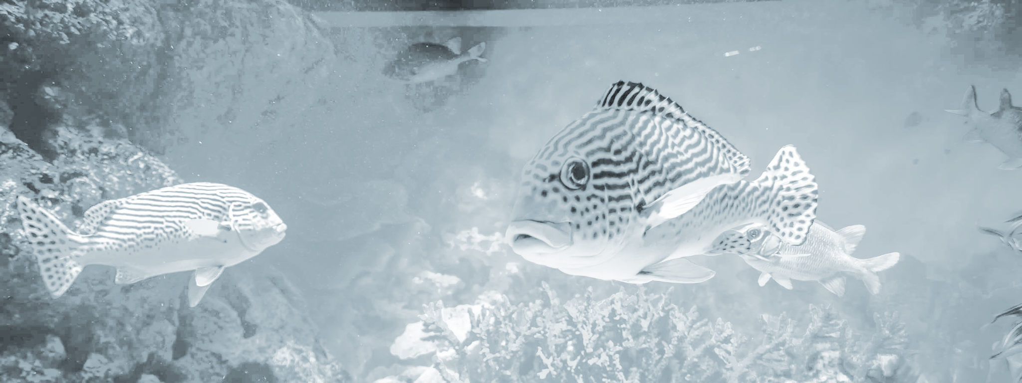
Aquarium Management
Mobile and Pervasive Computing Systems
2021/22 · Prof. Vítor Duarte
Alexandre Correia (53298)
Hugo Rodrigues (53309)
Notes:
Hugo

Slide 2
Problem
&
Goal
Notes:
Hugo

Slide 3

Problem
Goal
Different fish require different living conditions
People need to measure these conditions very often
Avoid the constant manual measurements
Users can access the temperature and PH levels of through the mobile app
Users can access and control the brightness of the aquarium through the mobile app
Notes:
Hugo

Slide 4
Proposal
Notes:
Alexandre

Slide 5
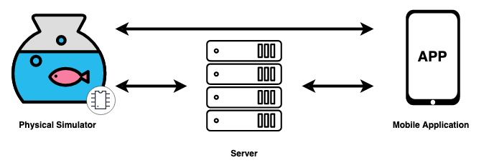
Architecture
Proposal
Notes:
Alexandre

Slide 6

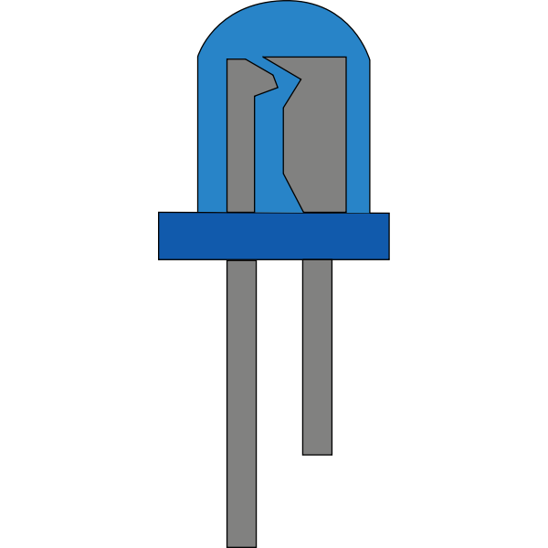
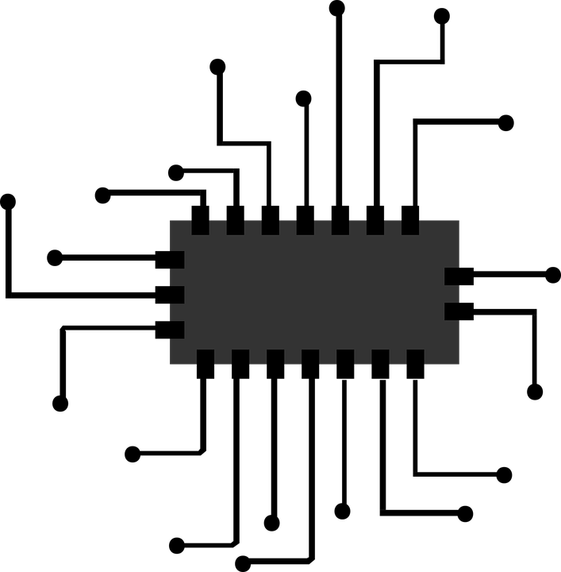
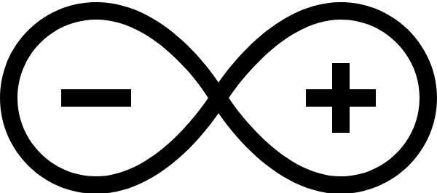
Architecture
Proposal
Notes:
Alexandre

Slide 7




Architecture
Proposal
Notes:
Alexandre

Slide 8


Architecture
Proposal
Notes:
Alexandre

Slide 9


Architecture
Proposal
Remote
Local
Notes:
Alexandre

Slide 10

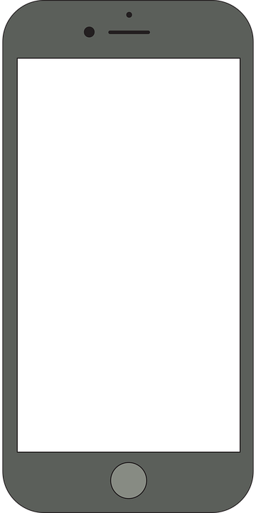
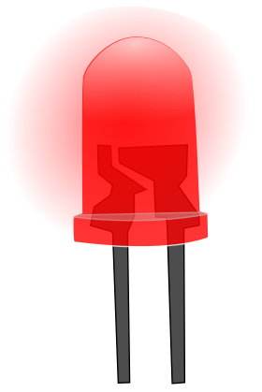
Temperature access/control
Proposal - Features
Measure (simulate)
Access
1 Potentiometer
App
Out of bounds warning
1 Red LED
App
Notes:
Hugo

Slide 11

PH access/control
Proposal - Features
Measure (simulate)
Access
1 Potentiometer
App
Out of bounds warning
1 Yellow LED
App
Notes:
Hugo

Slide 12

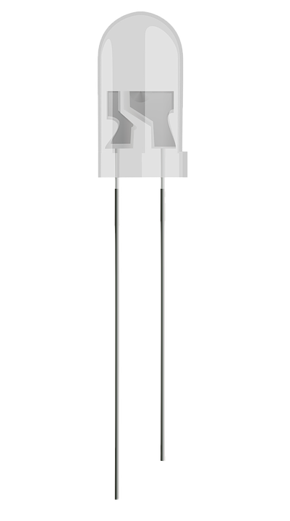
Brightness access/control
Proposal - Features
Measure ambient light
Access
1 Photoresistor
Auto mode
App
Manual mode
App
Aquarium's brightness
4 White LEDs
Notes:
Hugo

Slide 13
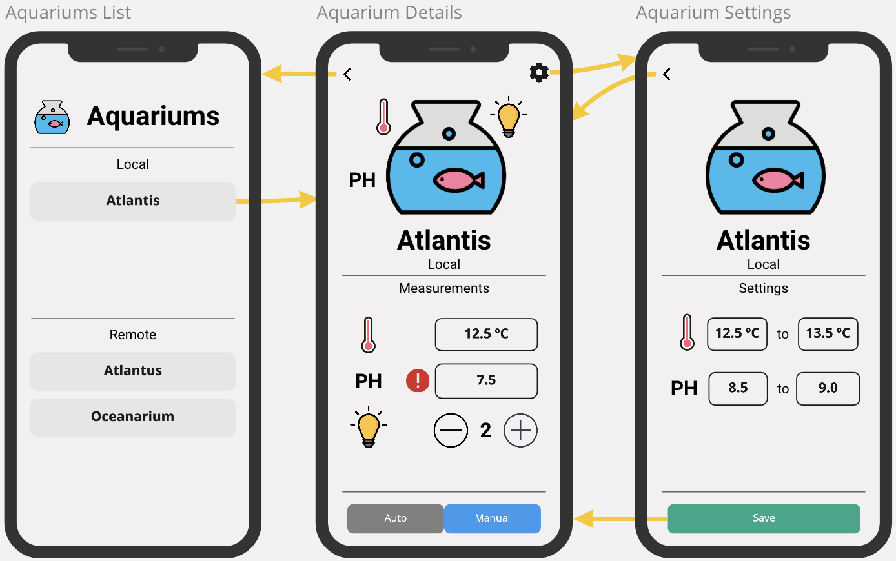
Mobile Application (Android)
Proposal
Notes:
Hugo

