Slide 1
Redes de Computadores
Computer Networks
labs
‹#›
Notes:
‹#›
2012/2013
LEI - DI/FCT/UNL
Redes de Computadores

Slide 2
Message oriented network programming with UDP sockets
Lab class #1
‹#›
Notes:
‹#›
2012/2013
LEI - DI/FCT/UNL
Redes de Computadores

Slide 3
Summary
Client/Server model
Java Example
Exercise: File transfer
‹#›

Slide 4
Client/Server Model
Two autonomous components:
  Server, first to run and usually always running.
  Client, usually started by user to request a service…
‹#›
Notes:
‹#›
2012/2013
LEI - DI/FCT/UNL
Redes de Computadores

Slide 5
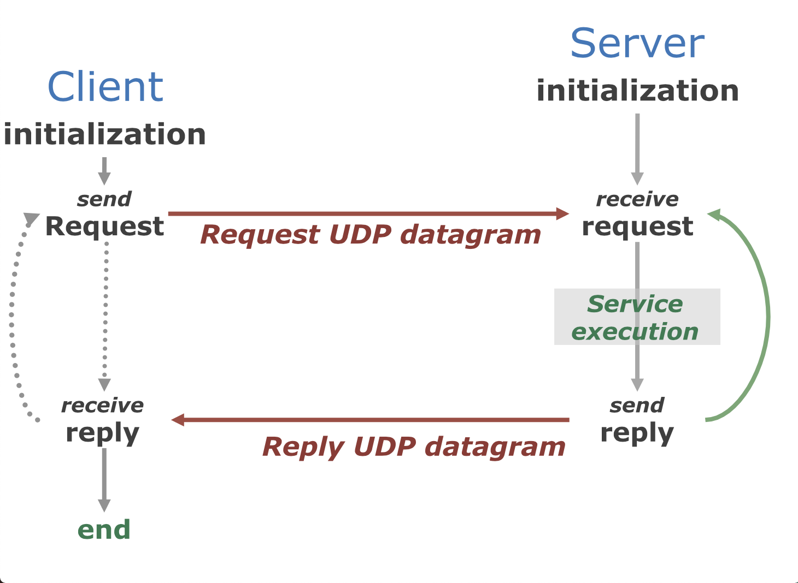
C/S with UDP datagrams
Notes:
‹#›
2012/2013
LEI - DI/FCT/UNL
Redes de Computadores

Slide 6
What’s an UDP Datagram?
Raw byte sequence (at most 64K long)
Addressed to a host (IP) and a process (port)
From a host (IP) and a port (port)
Called an UDP datagram
‹#›

Slide 7
UDP Datagram
32 bits
Other fields of the IP header
IP Header
(20 bytes w/
options)
Origin IP address (32 bits)
Destination IP address (32 bits)
Source port (16 bits)
Destination port (16 bits)
UDP Header
(8 bytes)
Datagram length (16 bits)
Checksum UDP (16 bits)
Payload do datagrama UDP
Application data (Payload)
Data or payload
(64K - 28 bytes)
‹#›

Slide 8
Datagrams communication
Communication is based on sockets
  End point abstraction with all the operations…
Addresses identify sender and receiver.
  Host (IP Address)
    10.1.233.67, 127.0.0.1, 192.168.1.1, etc.
  Port (16 bits)
    8000
‹#›
Notes:
‹#›
2012/2013
LEI - DI/FCT/UNL
Redes de Computadores

Slide 9



Datagrams communication
UDP datagram
Port: P_{x}
Port: P_{z}
Socket UDP: IP_{k}, P_{x}
Socket UDP: IP_{y}, P_{z}
Client
Program
Server
Program
IP Address: IP_{k}
IP Address: IP_{y}
Redes de Computadores - MIEI- DI/FCT/UNL
‹#›

Slide 10
Example: ECHO
Client sends a string message to server (IP + port).
Server sends back a copy of that string to client.
‹#›

Slide 11
Java Programming with UDP Datagrams
Java package:
  java.net
Java classes:
  DatagramSocket
  DatagramPacket
  InetAddress
‹#›
Notes:
‹#›
2012/2013
LEI - DI/FCT/UNL
Redes de Computadores

Slide 12
Java code (ECHO)
Server ECHO (EchoServer.java)
Client ECHO (EchoClient.java)
‹#›
Notes:
‹#›
2012/2013
LEI - DI/FCT/UNL
Redes de Computadores

Slide 13
Class InetAddress
InetAddress myself = InetAddress.getByName("localhost");
InetAddress myself =
InetAddress.getByName("127.0.0.1");
InetAddress myself = InetAddress.getLocalHost();
InetAddress server =
InetAddress.getByName("www.wikipedia.org");
InetAddress server = InetAddress.getByName("200.10.78.9");
InetAddress [ ] servers =
InetAddress.getAllByName("google.com");
‹#›

Slide 14
Class DatagramPacket
Scanner in = new Scanner( System.in );
System.out.printf("Type a message: ");
String msg = in.nextLine();
byte[] msgData = msg.getBytes();
DatagramPacket request = new DatagramPacket(msgData,
msgData.length, server, port);
socket.send(request);
‹#›

Slide 15
Receiving a DatagramPacket
byte[] buffer = new byte[MAXMSG];
DatagramPacket reply = new DatagramPacket(buffer,
buffer.length);
socket.receive(reply);
‹#›

Slide 16
Sockets UDP
Port: P_{y}
Client
Program
Queue in
Socket UDP: IP_{x}, P_{y}
Queue out
IP Address: IP_{x}
‹#›
Notes:
‹#›
2012/2013
LEI - DI/FCT/UNL
Redes de Computadores

Slide 17
Exercise: File Transfer
Implement a system capable of transferring files between two computers
  A client program (sender) sends a file to a server (receiver). If it exists, in the client computer, it sends its content to the server, using 1024 bytes blocks.
  Design the communication protocol so that:
    The client initially sends the file name to the server
    Then, the client sends all file blocks
    The client and the server know when the file ends
‹#›
Notes:
‹#›
2012/2013
LEI - DI/FCT/UNL
Redes de Computadores

Slide 18
Exercise: File Transfer
Client/server interaction:
Server
inicialization
Client
initialization
Send file name
send
receive
Send block #1
Receive file
Send file
. . .
Last block sent
Send last block
Last block received
End
End
‹#›

Slide 19
Exercise: File Transfer
Check that the receiver can lose some blocks
  Use a big file (>=10MBytes)
Try to solve the problem and evaluate:
  Use Thread.sleep() so that the sender waits a little before sending each block
  Verify the time you must use when: in the same computer; between different computers; if possible, computers in different networks.
  Compute the transfer rate (KB/s) achieved in each case
‹#›

